Slide 1
15-505
Internet Search Technologies
Lecture 8: Clustering
Kamal Nigam
Slides adapted from Chris Manning, Prabhakar Raghavan, and Hinrich Schütze (http://www-csli.stanford.edu/~hinrich/information-retrieval-book.html),
William Cohen (www.cs.cmu.edu/~wcohen/Matching-2.ppt), &
Ray Mooney (http://www.cs.utexas.edu/~mooney/cs391L/slides/clustering.ppt)

Slide 2
What is clustering?
Clustering: the process of grouping a set of objects into classes of similar objects
Most common form of unsupervised learning
    Unsupervised learning = learning from raw data, as opposed to supervised data where a classification of examples is given

Slide 3
Clustering
Notes:
Here I’m showing some data to cluster
Let’s say high-D data, but projected it down to 2 most important dimensions for clustering
It’s obvious to us even with 2-D projection that red points shouldn’t be in same cluster
But, standard clustering algorithm like GAC needs to compare these using all dimensions of the data
However, different story for the blue points.
Here, using the projection, we don’t know if they are in the same cluster.
We’d want to use the high-D metric to determine if there should be clustered together or apart.
We can encode exactly this type of information in an overlapping clustering of the data created by the inexpensive distance metric

Slide 4
Clustering
Notes:
Here I’m showing some data to cluster
Let’s say high-D data, but projected it down to 2 most important dimensions for clustering
It’s obvious to us even with 2-D projection that red points shouldn’t be in same cluster
But, standard clustering algorithm like GAC needs to compare these using all dimensions of the data
However, different story for the blue points.
Here, using the projection, we don’t know if they are in the same cluster.
We’d want to use the high-D metric to determine if there should be clustered together or apart.
We can encode exactly this type of information in an overlapping clustering of the data created by the inexpensive distance metric

Slide 5
Clustering – Reference matching
Fahlman, Scott & Lebiere, Christian (1989). The cascade-correlation learning architecture. In Touretzky, D., editor, Advances in Neural Information Processing Systems (volume 2), (pp. 524-532), San Mateo, CA. Morgan Kaufmann.
Fahlman, S.E. and Lebiere, C., “The Cascade Correlation Learning Architecture,” NIPS, Vol. 2, pp. 524-532, Morgan Kaufmann, 1990.
Fahlman, S. E. (1991) The recurrent cascade-correlation learning architecture. In Lippman, R.P. Moody, J.E., and Touretzky, D.S., editors, NIPS 3, 190-205.
Notes:
Task: clustering bibliographic citations
Here are 3 citations from bibliography sections of 3 different papers. First two clustered together. Third refers to different paper and forms separate cluster
Note that variations in formatting, field ordering, abbreviation and even misspellings and misinformation make this a challenging clustering problem.
Why collected this data?

Slide 6
Clustering – Reference matching
Fahlman, Scott & Lebiere, Christian (1989). The cascade-correlation learning architecture. In Touretzky, D., editor, Advances in Neural Information Processing Systems (volume 2), (pp. 524-532), San Mateo, CA. Morgan Kaufmann.
Fahlman, S.E. and Lebiere, C., “The Cascade Correlation Learning Architecture,” NIPS, Vol. 2, pp. 524-532, Morgan Kaufmann, 1990.
Fahlman, S. E. (1991) The recurrent cascade-correlation learning architecture. In Lippman, R.P. Moody, J.E., and Touretzky, D.S., editors, NIPS 3, 190-205.
Notes:
Task: clustering bibliographic citations
Here are 3 citations from bibliography sections of 3 different papers. First two clustered together. Third refers to different paper and forms separate cluster
Note that variations in formatting, field ordering, abbreviation and even misspellings and misinformation make this a challenging clustering problem.
Why collected this data?

Slide 7
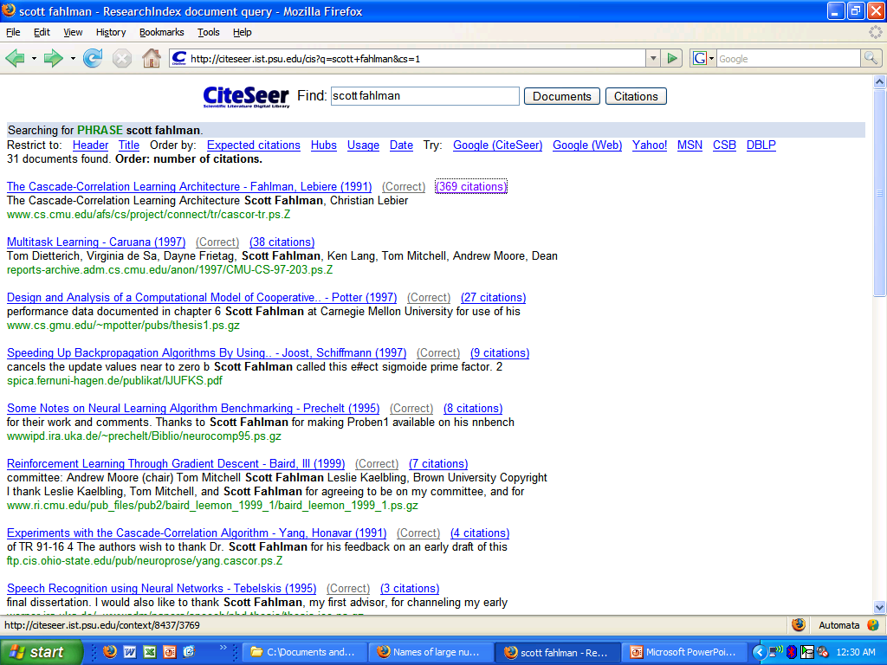
Citation ranking

Slide 8
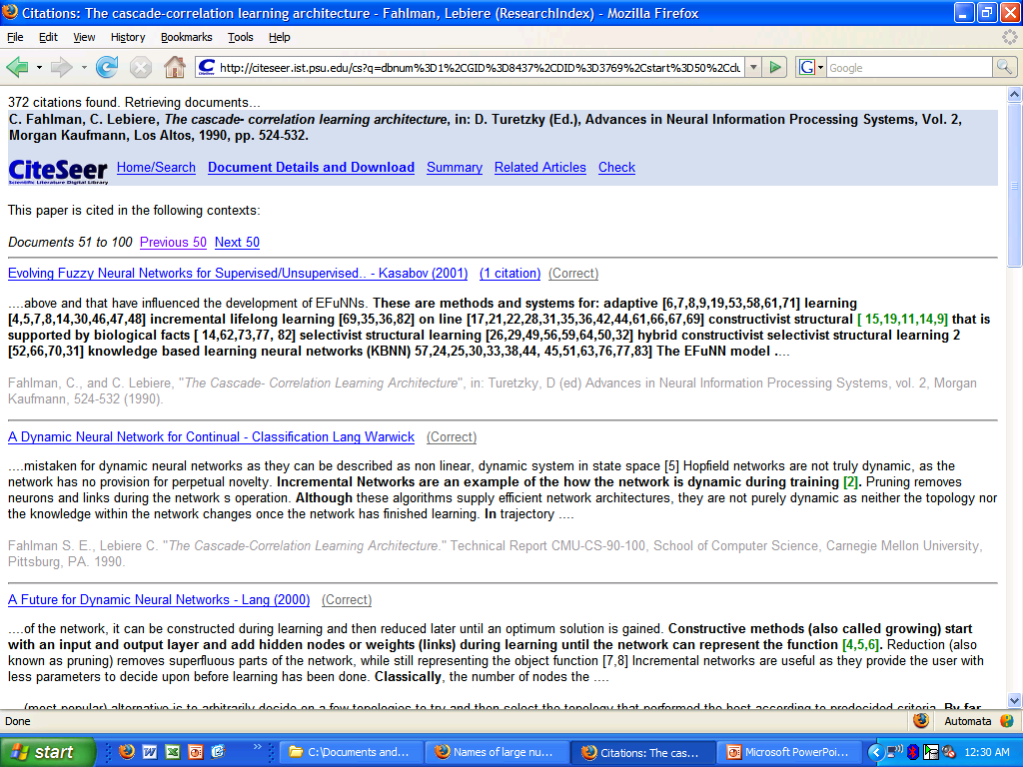
Citation graph browsing

Slide 9
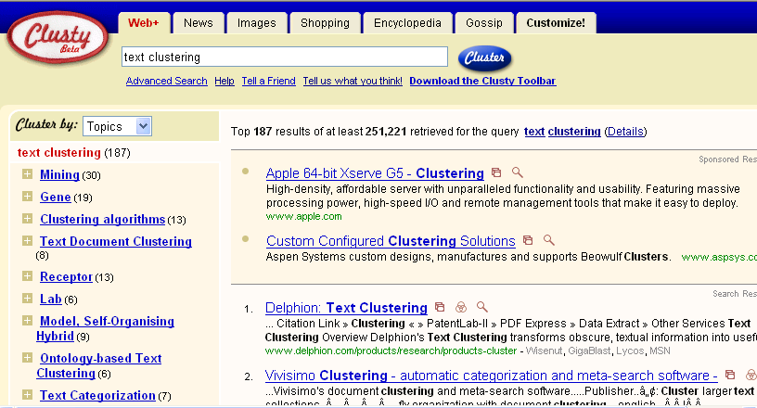
Clustering: Navigation of search results
For grouping search results thematically
  clusty.com / Vivisimo

Slide 10
Clustering: Corpus browsing
www.yahoo.com/Science
… (30)
agriculture
biology
physics
CS
space
...
...
...
...
...
dairy
crops
botany
cell
AI
courses
craft
magnetism
HCI
missions
forestry
agronomy
evolution
relativity
Notes:
Final data set:
Yahoo Science hierarchy, consisting of text of web pages pointed to by Yahoo, gathered summer of 1997.
264 classes, only sample shown here.

Slide 11
Clustering considerations
What does it mean for objects to be similar?
What algorithm and approach do we take?
  Top-down: k-means
  Bottom-up: hierarchical agglomerative clustering
Do we need a hierarchical arrangement of clusters?
How many clusters?
Can we label or name the clusters?
How do we make it efficient and scalable?

Slide 12
What makes docs “related”?
Ideal: semantic similarity.
Practical: statistical similarity
  Treat documents as vectors
  For many algorithms, easier to think in terms of a distance (rather than similarity) between docs.
  Think of either cosine similarity or Euclidean distance

Slide 13
What are we optimizing?
Given: Final number of clusters
Optimize:
  “Tightness” of clusters
  {average/min/max/} distance of points to each other in the same cluster?
  {average/min/max} distance of points to each clusters center?
Usually clustering finds heuristic approximations

Slide 14
Clustering Algorithms
Partitional algorithms
  Usually start with a random (partial) partitioning
  Refine it iteratively
    K means clustering
    Model based clustering
Hierarchical algorithms
  Bottom-up, agglomerative
  Top-down, divisive

Slide 15
Partitioning Algorithms
Partitioning method: Construct a partition of n documents into a set of K clusters
Given: a set of documents and the number K
Find: a partition of K clusters that optimizes the chosen partitioning criterion
  Globally optimal: exhaustively enumerate all partitions
  Effective heuristic methods: K-means algorithms

Slide 16
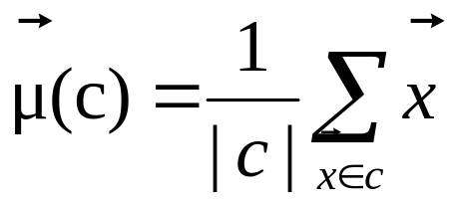
K-Means
Assumes documents are real-valued vectors.
Clusters based on centroids (aka the center of gravity or mean) of points in a cluster, c:
Reassignment of instances to clusters is based on distance to the current cluster centroids.

Slide 17
K-Means Algorithm
Select K random seeds.
Until clustering converges or other stopping criterion:
For each doc d_{i}:
Assign d_{i} to the cluster c_{j} such that dist(x_{i}, s_{j}) is minimal.
(Update the seeds to the centroid of each cluster)
For each cluster c_{j}
s_{j} = μ(c_{j})
How?

Slide 18
K Means Example
(K=2)
Pick seeds
Reassign clusters
Compute centroids
Reassign clusters
x
x
x
Compute centroids
x
x
x
Reassign clusters
Converged!

Slide 19
Termination conditions
Several possibilities, e.g.,
  A fixed number of iterations.
  Doc partition unchanged.
  Centroid positions don’t change.
Does this mean that the docs in a cluster are unchanged?

Slide 20
Convergence
Why should the K-means algorithm ever reach a fixed point?
  A state in which clusters don’t change.
K-means is a special case of a general procedure known as the Expectation Maximization (EM) algorithm.
  EM is known to converge.
  Theoretically, number of iterations could be large.
  Typically converges quickly

Slide 21
Time Complexity
Computing distance between doc and cluster is O(m) where m is the dimensionality of the vectors.
Reassigning clusters: O(Kn) distance computations, or O(Knm).
Computing centroids: Each doc gets added once to some centroid: O(nm).
Assume these two steps are each done once for I iterations: O(IKnm).

Slide 22

Seed Choice
Results can vary based on random seed selection.
Some seeds can result in poor convergence rate, or convergence to sub-optimal clusterings.
  Select good seeds using a heuristic (e.g., doc least similar to any existing mean)
  Try out multiple starting points
  Initialize with the results of another method.
Example showing
sensitivity to seeds
In the above, if you start
with B and E as centroids
you converge to {A,B,C}
and {D,E,F}
If you start with D and F
you converge to
{A,B,D,E} {C,F}

Slide 23
How Many Clusters?
Number of clusters K is given
  Partition n docs into predetermined number of clusters
Finding the “right” number of clusters is part of the problem
  Given data, partition into an “appropriate” number of subsets.
  E.g., for query results - ideal value of K not known up front - though UI may impose limits.
Can usually take an algorithm for one flavor and convert to the other.

Slide 24
K not specified in advance
Say, the results of a query.
Solve an optimization problem: penalize having lots of clusters
  application dependent, e.g., compressed summary of search results list.
Tradeoff between having more clusters (better focus within each cluster) and having too many clusters

Slide 25
K not specified in advance
Given a clustering, define the Benefit for a doc to be some inverse distance to its centroid
Define the Total Benefit to be the sum of the individual doc Benefits.

Slide 26
Penalize lots of clusters
For each cluster, we have a Cost C.
Thus for a clustering with K clusters, the Total Cost is KC.
Define the Value of a clustering to be =
  Total Benefit - Total Cost.
Find the clustering of highest value, over all choices of K.
  Total benefit increases with increasing K. But can stop when it doesn’t increase by “much”. The Cost term enforces this.

Slide 27
Hierarchical Clustering
Build a tree-based hierarchical taxonomy (dendrogram) from a set of documents.
animal
vertebrate
invertebrate
fish reptile amphib. mammal worm insect crustacean
How could you do this with k-means?

Slide 28
Hierarchical Clustering algorithms
Agglomerative (bottom-up):
  Start with each document being a single cluster.
  Eventually all documents belong to the same cluster.
Divisive (top-down):
  Start with all documents belong to the same cluster.
  Eventually each node forms a cluster on its own.
  Could be a recursive application of k-means like algorithms
Does not require the number of clusters k in advance
Needs a termination/readout condition

Slide 29
Hierarchical Agglomerative Clustering (HAC)
Assumes a similarity function for determining the similarity of two instances.
Starts with all instances in a separate cluster and then repeatedly joins the two clusters that are most similar until there is only one cluster.
The history of merging forms a binary tree or hierarchy.

Slide 30
Dendogram: Hierarchical Clustering
  Clustering obtained by cutting the dendrogram at a desired level: each connected component forms a cluster.

Slide 31
Hierarchical Agglomerative Clustering (HAC)
Starts with each doc in a separate cluster
  then repeatedly joins the closest pair of clusters, until there is only one cluster.
The history of merging forms a binary tree or hierarchy.
How to measure distance of clusters??

Slide 32
Closest pair of clusters
Many variants to defining closest pair of clusters
Single-link
  Distance of the “closest” points (single-link)
Complete-link
  Distance of the “furthest” points
Centroid
  Distance of the centroids (centers of gravity)
(Average-link)
  Average distance between pairs of elements

Slide 33
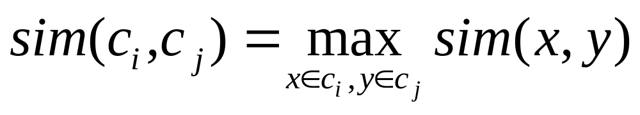
Single Link Agglomerative Clustering
Use maximum similarity of pairs:
Can result in “straggly” (long and thin) clusters due to chaining effect.
After merging c_{i} and c_{j}, the similarity of the resulting cluster to another cluster, c_{k}, is:

Slide 34
Single Link Example

Slide 35
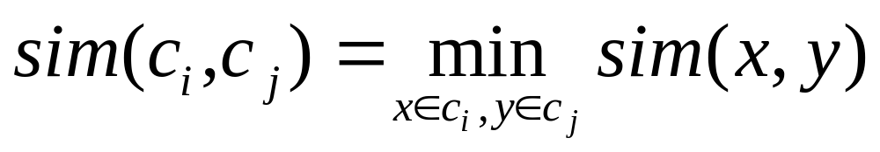
Complete Link Agglomerative Clustering
Use minimum similarity of pairs:
Makes “tighter,” spherical clusters that are typically preferable.
After merging c_{i} and c_{j}, the similarity of the resulting cluster to another cluster, c_{k}, is:
C_{i}
C_{j}
C_{k}

Slide 36
Complete Link Example

Slide 37
Key notion: cluster representative
We want a notion of a representative point in a cluster
Representative should be some sort of “typical” or central point in the cluster, e.g.,
  point inducing smallest radii to docs in cluster
  smallest squared distances, etc.
  point that is the “average” of all docs in the cluster
    Centroid or center of gravity

Slide 38
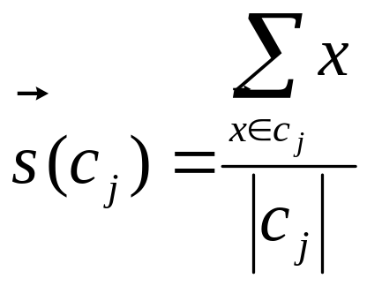
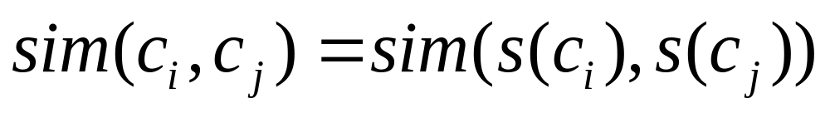
Centroid-based Similarity
Always maintain average of vectors in each cluster:
Compute similarity of clusters by:
For non-vector data, can’t always make a centroid

Slide 39
Computational Complexity
In the first iteration, all HAC methods need to compute similarity of all pairs of n individual instances which is O(mn²).
In each of the subsequent n−2 merging iterations, compute the distance between the most recently created cluster and all other existing clusters.
Maintaining of heap of distances allows this to be O(mn²logn)

Slide 40
Major issue - labeling
After clustering algorithm finds clusters - how can they be useful to the end user?
Need pithy label for each cluster
  In search results, say “Animal” or “Car” in the jaguar example.
  In topic trees, need navigational cues.
    Often done by hand, a posteriori.
How would you do this?

Slide 41
How to Label Clusters
Show titles of typical documents
  Titles are easy to scan
  Authors create them for quick scanning!
  But you can only show a few titles which may not fully represent cluster
Show words/phrases prominent in cluster
  More likely to fully represent cluster
  Use distinguishing words/phrases
    Differential labeling
  But harder to scan

Slide 42
Labeling
Common heuristics - list 5-10 most frequent terms in the centroid vector.
  Drop stop-words; stem.
Differential labeling by frequent terms
  Within a collection “Computers”, clusters all have the word computer as frequent term.
  Discriminant analysis of centroids.
Perhaps better: distinctive noun phrase

Slide 43
Scaling up to large datasets
Fahlman, Scott & Lebiere, Christian (1989). The cascade-correlation learning architecture. In Touretzky, D., editor, Advances in Neural Information Processing Systems (volume 2), (pp. 524-532), San Mateo, CA. Morgan Kaufmann.
Fahlman, S.E. and Lebiere, C., “The Cascade Correlation Learning Architecture,” NIPS, Vol. 2, pp. 524-532, Morgan Kaufmann, 1990.
Fahlman, S. E. (1991) The recurrent cascade-correlation learning architecture. In Lippman, R.P. Moody, J.E., and Touretzky, D.S., editors, NIPS 3, 190-205.
Notes:
Task: clustering bibliographic citations
Here are 3 citations from bibliography sections of 3 different papers. First two clustered together. Third refers to different paper and forms separate cluster
Note that variations in formatting, field ordering, abbreviation and even misspellings and misinformation make this a challenging clustering problem.
Why collected this data?

Slide 44
Efficient large-scale clustering
17M biomedical papers in Medline
Each paper contains ~20 citations
Clustering 340M citations
~10¹⁷ distance calculations for naïve HAC
Notes:
Collected over 1 million citations
Estimate 100,000 unique papers
Vocabulary used about 100,000 unique words
Performing single link GAC - trillion distances (all pairs)
Exacerbating this is expensive distance metric
String edit distance, DP
implementation & hardware… > 1 year

Slide 45
Expensive Distance Metric for Text
String edit distance
Compute with dynamic programming
Costs for character:
  insertion
  deletion
  substitution
  ...
 |  | S | e | c | a | t
 | 0.0 | 0.7 | 1.4 | 2.1 | 2.8 | 3.5
S | 0.7 | 0.0 | 0.7 | 1.1 | 1.4 | 1.8
c | 1.4 | 0.7 | 1.0 | 0.7 | 1.4 | 1.8
o | 2.1 | 1.1 | 1.7 | 1.4 | 1.7 | 2.4
t | 2.8 | 1.4 | 2.1 | 1.8 | 2.4 | 1.7
t | 3.5 | 1.8 | 2.4 | 2.1 | 2.8 | 2.4
Notes:
Word matching doesn’t capture order of words, variation in punctuation, misspellings, etc.
String edit distance!
But, need to solve dynamic program
Different costs for operations

Slide 46
String edit (Levenstein) distance
Distance is shortest sequence of edit commands that transform s to t.
Simplest set of operations:
  Copy character from s over to t
  Delete a character in s (cost 1)
  Insert a character in t (cost 1)
  Substitute one character for another (cost 1)

Slide 47
Levenstein distance - example
distance(“William Cohen”, “Willliam Cohon”)
s
W | I | L | L | I | A | M | _ | C | O | H | E |  | N
W | I | L | L | L | I | A | M | _ | C | O | H | O | N
C | C | C | C | I | C | C | C | C | C | C | C | S | C
0 | 0 | 0 | 0 | 1 | 1 | 1 | 1 | 1 | 1 | 1 | 1 | 2 | 2
alignment
t
op
cost

Slide 48
Levenstein distance - example
distance(“William Cohen”, “Willliam Cohon”)
s
W | I | L | L |  | I | A | M | _ | C | O | H | E | N
W | I | L | L | L | I | A | M | _ | C | O | H | O | N
C | C | C | C | I | C | C | C | C | C | C | C | S | C
0 | 0 | 0 | 0 | 1 | 1 | 1 | 1 | 1 | 1 | 1 | 1 | 2 | 2
gap
alignment
t
op
cost

Slide 49
Computing Levenstein distance
D(i,j) = score of best alignment from s1..si to t1..tj
D(i-1,j-1), if si=tj //copy
D(i-1,j-1)+1, if si!=tj //substitute
D(i-1,j)+1 //insert
D(i,j-1)+1 //delete
= min

Slide 50
Computing Levenstein distance
 |  | C | O |  | H | E | N
M |  | 1 | 2 |  | 3 | 4 | 5
C |  | 1 | 2 |  | 3 | 4 | 5
C |  | 2 | 2 |  | 3 | 4 | 5
O |  | 3 | 2 |  | 3 | 4 | 5
H |  | 4 | 3 |  | 2 | 3 | 4
N |  | 5 | 4 |  | 3 | 3 | 3
= D(s,t)

Slide 51
Computing Levenstein distance
 |  | C | O |  | H | E | N
M |  | 1 | 2 |  | 3 | 4 | 5
C |  | 1 | 2 |  | 3 | 4 | 5
C |  | 2 | 3 |  | 3 | 4 | 5
O |  | 3 | 2 |  | 3 | 4 | 5
H |  | 4 | 3 |  | 2 | 3 | 4
N |  | 5 | 4 |  | 3 | 3 | 3
A trace indicates where the min value came from, and can be used to find edit operations and/or a best alignment (may be more than 1)

Slide 52
Large Clustering Problems
Many examples
Many clusters
Many dimensions
Example Domains
Text
Images
Protein structure
Notes:
This task prototypical of other large clustering problems in that it is large in three distinct ways…
Text domains: householding address data, clustering product descriptions and technical specifications extracted from the web
Standard clustering algorithms on these domains are very expensive

Slide 53
The Canopies Approach
Two distance metrics: cheap & expensive
First Pass
  very inexpensive distance metric
  create overlapping canopies
Second Pass
  expensive, accurate distance metric
  canopies determine which distances calculated
Notes:
Key idea: 2 distance metrics
In addition to expensive and accurate, very inexpensive but less accurate
Clustering proceeds in 2 phases.
First phase: inexpensive metric
Quickly create rough clustering
Produces set of overlapping clusters we call canopies
Second phase: use the expensive accurate metric
Modified version of standard clustering (like EM, GAC, k-means)
Modifications to algorithm use canopies to reduce number of distance calculations
This is where the computational savings comes from in dramatically reducing expensive distances
Let me explain in more detail with an illustration

Slide 54
Illustrating Canopies
Notes:
Here I’m showing some data to cluster
Let’s say high-D data, but projected it down to 2 most important dimensions for clustering
It’s obvious to us even with 2-D projection that red points shouldn’t be in same cluster
But, standard clustering algorithm like GAC needs to compare these using all dimensions of the data
However, different story for the blue points.
Here, using the projection, we don’t know if they are in the same cluster.
We’d want to use the high-D metric to determine if there should be clustered together or apart.
We can encode exactly this type of information in an overlapping clustering of the data created by the inexpensive distance metric

Slide 55
Overlapping Canopies
Notes:
Here is a set of canopies created by the 2-dimensional inexpensive distance metric we can see
2 blue points share common canopy indicating that inexpensive distance metric cannot determine that fall into separate clusters
2 red point fall into completely disjoint canopies indicating that they will not fall into the same cluster
Note that canopies created are overlapping. We allow canopies to overlap b/c of the inaccuracies of the inexpensive distance metric.
How might we create these canopies quickly with an inexpensive metric?

Slide 56
Creating canopies with two thresholds
Put all points in D
Loop:
  Pick a point X from D
  Put points within
  K_{loose} of X in canopy
  Remove points within K_{tight} of X from D
tight
loose
Notes:
One inexpensive way:
Method of two thresholds:
Every point in inner threshold of at least one canopy
Given canopies, how alter original clustering algorithm?

Slide 57
Using canopies with HAC
Calculate expensive distances between points in the same canopy
All other distances default to infinity
Use finite distances and iteratively merge closest
Notes:
Take the example of single-link GAC:
Normally, compute all pairs of distances, sort and merge until threshold or # clusters
Here, only need to compute distances of ones in same cluster. Others default to infinity.
In the paper, we’ve detailed Similar modifications for other GACs, K-means, EM...

Slide 58
Inexpensive Distance Metric for Text
Word-level matching (TFIDF)
Inexpensive using an inverted index
aardvark
ant
apple
...
...
zoo
Notes:
One fast, efficient metric for text is the TFIDF measure that measures a word-level matching score. Variants used by search engines.
Store data in inverted index
Two-thresholds means can avoid all pairs comparison
For non-text domains not hard to imagine inexpensive metrics using just a few features

Slide 59
Expensive Distance Metric for Text
String edit distance
Compute with dynamic programming
Costs for character:
  insertion
  deletion
  substitution
  ...
 |  | S | e | c | a | t
 | 0.0 | 0.7 | 1.4 | 2.1 | 2.8 | 3.5
S | 0.7 | 0.0 | 0.7 | 1.1 | 1.4 | 1.8
c | 1.4 | 0.7 | 1.0 | 0.7 | 1.4 | 1.8
o | 2.1 | 1.1 | 1.7 | 1.4 | 1.7 | 2.4
t | 2.8 | 1.4 | 2.1 | 1.8 | 2.4 | 1.7
t | 3.5 | 1.8 | 2.4 | 2.1 | 2.8 | 2.4
Notes:
Word matching doesn’t capture order of words, variation in punctuation, misspellings, etc.
String edit distance!
But, need to solve dynamic program
Different costs for operations

Slide 60
Computational Savings
inexpensive metric << expensive metric
  Canopy creation nearly for free
Number of canopies: c (large)
Number of canopies per point: f (small but > 1)
fn/c points per canopy (if evenly spread)
O(c(fn/c)²) distance calculations initially
Complexity reduction: O(f²/c)
Notes:
First phase of canopies clustering not a significant compuatational cost b/c:
Inexpensive metric << expensive metric
Canopy creation algorithm avoids the full N^2 distance calculations
For second phase characterize savings in terms of f & c
F: average number of canopies a point falls into
C: number of canopies
Optimisitically assume canopies roughly evenly sized
Savings is f^2/c
This is large b/c number of canopies roughly number of clusters
Scales with the size of the dataset

Slide 61
Canopies
Two distance metrics
  cheap and approximate
  expensive and accurate
Two-pass clustering
  create overlapping canopies
  full clustering with limited distances

Slide 62
Preserving Good Clustering
Small, disjoint canopies
big time savings
Large, overlapping canopies
original accurate clustering
Goal: fast and accurate
  For every cluster, there exists a canopy such that all points in the cluster are in the canopy
Notes:
When applying canopies procedure, would like to guarantee that the solution for the full clustering still possible.
With one canopy all points, same solution, no time savings.
Each canopy contains one points, bad solution, great time savings.
For solution to exist, want to guarantee…
In practice, we’ll see that accuracy not decreased

Slide 63
Feature selection
Which terms to use as axes for vector space?
Large body of (ongoing) research
IDF is a form of feature selection
  Can exaggerate noise e.g., mis-spellings
Better is to use highest weight mid-frequency words – the most discriminating terms
Pseudo-linguistic heuristics, e.g.,
  drop stop-words
  stemming/lemmatization
  use only nouns/noun phrases
Good clustering should “figure out” some of these

Slide 64
Extracting Fields using HMMs
Fahlman, S.E. and Lebiere, C., “The Cascade Correlation Learning Architecture,” NIPS, Vol. 2, pp. 524-532, Morgan Kaufmann, 1990.
Author: Fahlman, S.E. and Lebiere, C.
Title: The Cascade Correlation Learning Architecture
Venue: NIPS
Year: 1990
Notes:
Since fields appear in different order, hard to use stringedit directly.
HMM captures common format, layout and word distributions of citations.
Identifies all fields of citation… use only 4
Over 90% accurate
compute string edit distance for all four fields, and combine with weights

